Slide 1




The Rail Fanning Club
Welcome to
THE HUB OF RAIL FANS, COVERING EACH AND EVERY ASPECT OF INDIAN RAILWAYS & IT’S ALL RELATED SUBSIDIARIES.
India’s #1 Instagrammer, in the field of Indian Railways.

Slide 2

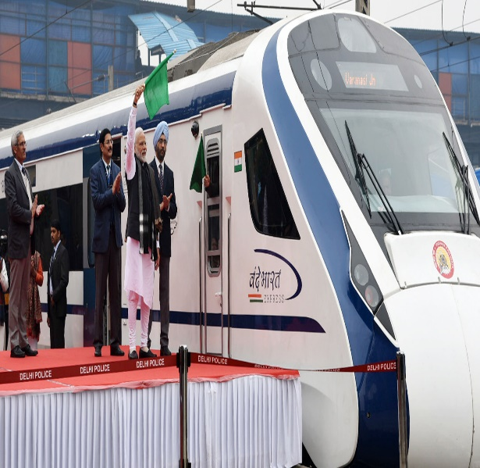

<--- Introduction to Today’s Topic --->
1
2
We are going to discuss over the history and present of “VANDE BHARAT EXPRESS”
If you require the video, on the topic :-
“Why tenders for VANDE BHARAT EXPRESS” got cancelled?”
Comment us below !!!

Slide 3
About VANDE BHARAT EXPRESS’s Inaugural
FIRST SERVICE – 23/02/2019
COST (for first rake) – Rs. 1 billion
CATEGORY – “Train-18”
CLASS(es) – A.C. Chair Car & A.C. Executive Class
Seating Arrangements – YES
Sleeping Arrangements – NO
Rake Type – L.H.B. (Linke-Hofmann Busch)
Manufactured by – I.C.F., Perambur, Chennai
as on Sep. 2020, it’s age is 18 months old.
Same – Day Return Journey
Notes:
When conducting research, it is easy to go to one source: Wikipedia. However, you need to include a variety of sources in your research. Consider the following sources:
Who can I interview to get more information on the topic?
Is the topic current and will it be relevant to my audience?
What articles, blogs, and magazines may have something related to my topic?
Is there a YouTube video on the topic? If so, what is it about?
What images can I find related to the topic?

Slide 4
About VANDE BHARAT EXPRESS’s Specialties
Odour Controllers
Sensor-based bio-toilets
Automated doors
Smoke alarms
CCTV cameras
Regenerative Braking System
Aerodynamic Body Shell
ADVANCED LEVEL
Notes:
When conducting research, it is easy to go to one source: Wikipedia. However, you need to include a variety of sources in your research. Consider the following sources:
Who can I interview to get more information on the topic?
Is the topic current and will it be relevant to my audience?
What articles, blogs, and magazines may have something related to my topic?
Is there a YouTube video on the topic? If so, what is it about?
What images can I find related to the topic?

Slide 5
VANDE BHARAT EXPRESS’s Current Status
There are two routes of “VANDE BHARAT EXPRESS”
  New Delhi – Varanasi Vande Bharat Express
  New Delhi – Shri Mata Vaishno Devi Vande Bharat Express
Seating Capacity – 1,128 passengers (16 coaches, incl. 2 Driver Cabs)
  DRIVER CABS – 52 seats
  NON-DRIVER CABS – 78 seats
Notes:
When conducting research, it is easy to go to one source: Wikipedia. However, you need to include a variety of sources in your research. Consider the following sources:
Who can I interview to get more information on the topic?
Is the topic current and will it be relevant to my audience?
What articles, blogs, and magazines may have something related to my topic?
Is there a YouTube video on the topic? If so, what is it about?
What images can I find related to the topic?

Slide 6
VANDE BHARAT EXPRESS’s Flag-off
FLAGED OFF by HONOURABLE PRIME MINISTER SHRI NARENDRA MODI, on 15/02/2020, for the route of NEW DELHI VARANASI VANDE BHARAT EXPRESS
It is flagged off, with vision to reduce travel time.
Notes:
When conducting research, it is easy to go to one source: Wikipedia. However, you need to include a variety of sources in your research. Consider the following sources:
Who can I interview to get more information on the topic?
Is the topic current and will it be relevant to my audience?
What articles, blogs, and magazines may have something related to my topic?
Is there a YouTube video on the topic? If so, what is it about?
What images can I find related to the topic?

Slide 7
VANDE BHARAT EXPRESS’s Speed
Operational Speed – 160 km/h / 200 km/h (*)
Maximum Permissible Speed – 130 km/h
Speed achieved during trials, at KOTA-SAWAI MADHOPUR rail line – 180 km/h
(*) ONLY FOR EXCEPTIONAL CASEs, or MAYBE POSSIBLE IN FUTURE.
Notes:
When conducting research, it is easy to go to one source: Wikipedia. However, you need to include a variety of sources in your research. Consider the following sources:
Who can I interview to get more information on the topic?
Is the topic current and will it be relevant to my audience?
What articles, blogs, and magazines may have something related to my topic?
Is there a YouTube video on the topic? If so, what is it about?
What images can I find related to the topic?

Slide 8
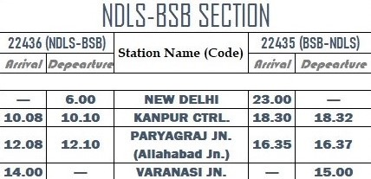
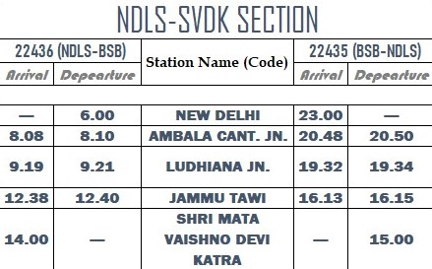
VANDE BHARAT EXPRESS’s Time Table & Train Schedule
Frequency – DAILY (except, MONDAY & THURSDAY) | Frequency – DAILY (except TUESDAY)
Notes:
When conducting research, it is easy to go to one source: Wikipedia. However, you need to include a variety of sources in your research. Consider the following sources:
Who can I interview to get more information on the topic?
Is the topic current and will it be relevant to my audience?
What articles, blogs, and magazines may have something related to my topic?
Is there a YouTube video on the topic? If so, what is it about?
What images can I find related to the topic?

Slide 9
Was there any real need for the Vande Bharat Express on the Indian Railways, or not? If yes, why was it needed?
Indian Railway don’t have any self-designed train-set.
Indian Railway also want to reduce travel time.
Indian Railway want to reduce the cost for manufacturing rolling stock.
Indian Railway also want provide Shatabdi, a special identity.
Notes:
When conducting research, it is easy to go to one source: Wikipedia. However, you need to include a variety of sources in your research. Consider the following sources:
Who can I interview to get more information on the topic?
Is the topic current and will it be relevant to my audience?
What articles, blogs, and magazines may have something related to my topic?
Is there a YouTube video on the topic? If so, what is it about?
What images can I find related to the topic?

Slide 10
Was Vande Bharat Express waste of tax money, done by Indian Railways?
DECIDE YOURSELF
According to me, it’s not a waste of taxes.
(REAL WASTE is UTKRISH COACHES)
Notes:
When conducting research, it is easy to go to one source: Wikipedia. However, you need to include a variety of sources in your research. Consider the following sources:
Who can I interview to get more information on the topic?
Is the topic current and will it be relevant to my audience?
What articles, blogs, and magazines may have something related to my topic?
Is there a YouTube video on the topic? If so, what is it about?
What images can I find related to the topic?

Slide 11
LIKE, SHARE, COMMENT
Thanks for watching
FOLLOW US ON INSTAGRAM
FOLLOW US ON TWITTER
Visit our website →
https://railfanningclub.travel.blog/

